Slide 1
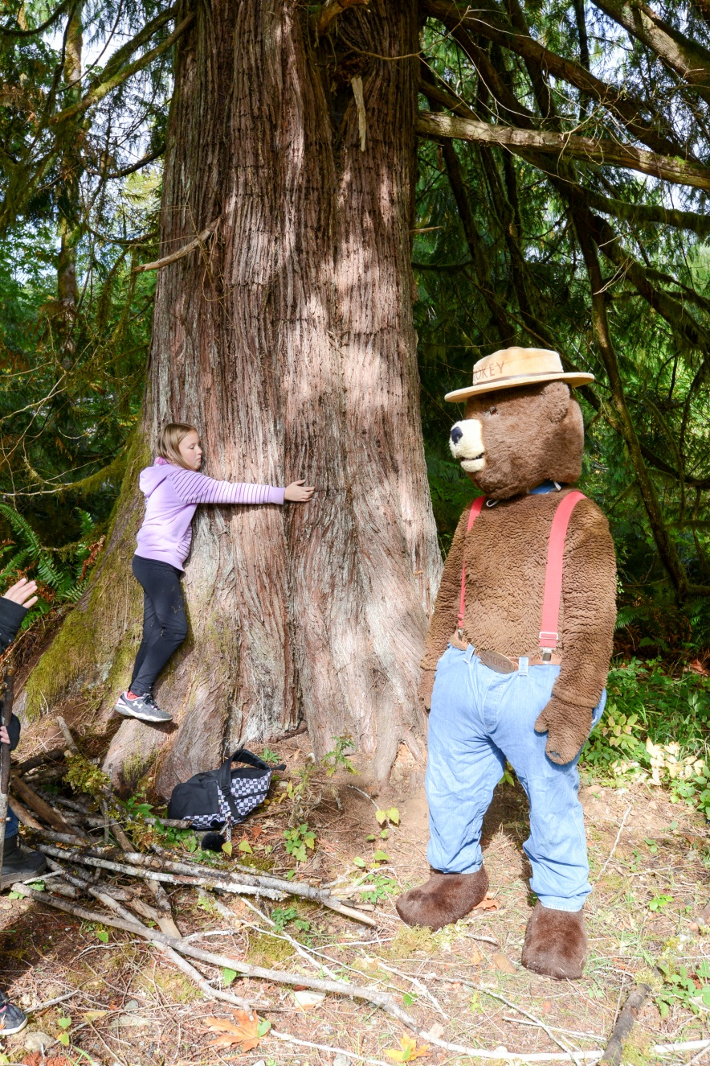
National Tree Day
2016
South Island Natural Resource District

Slide 2
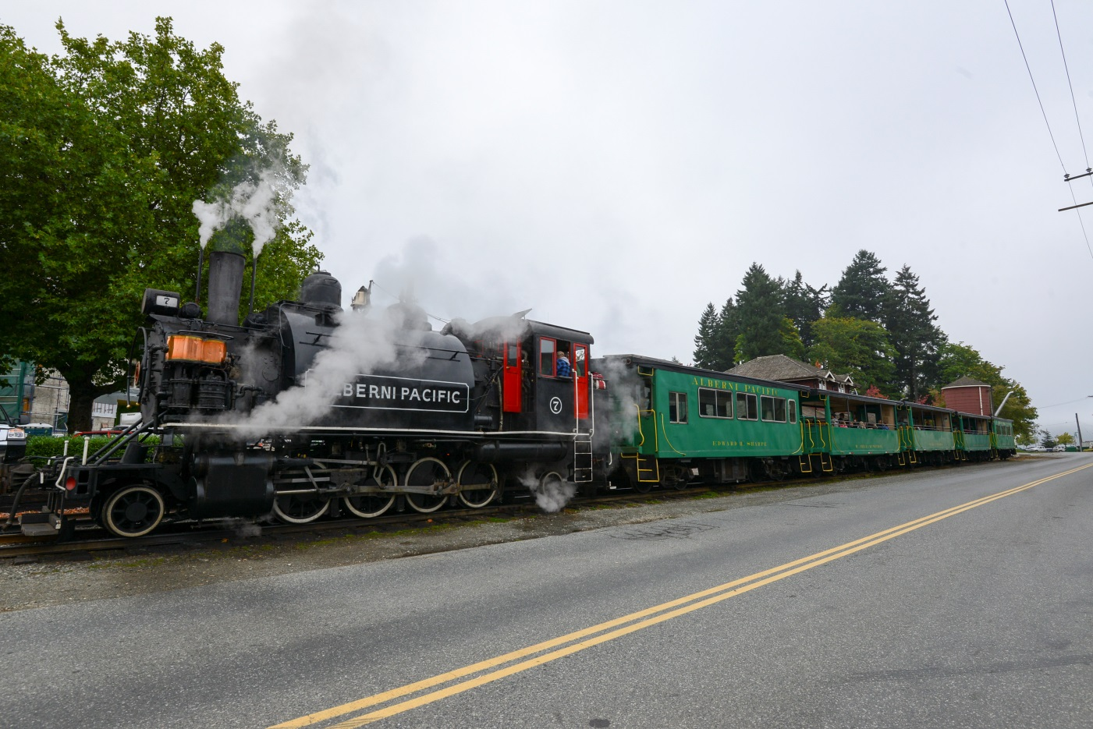
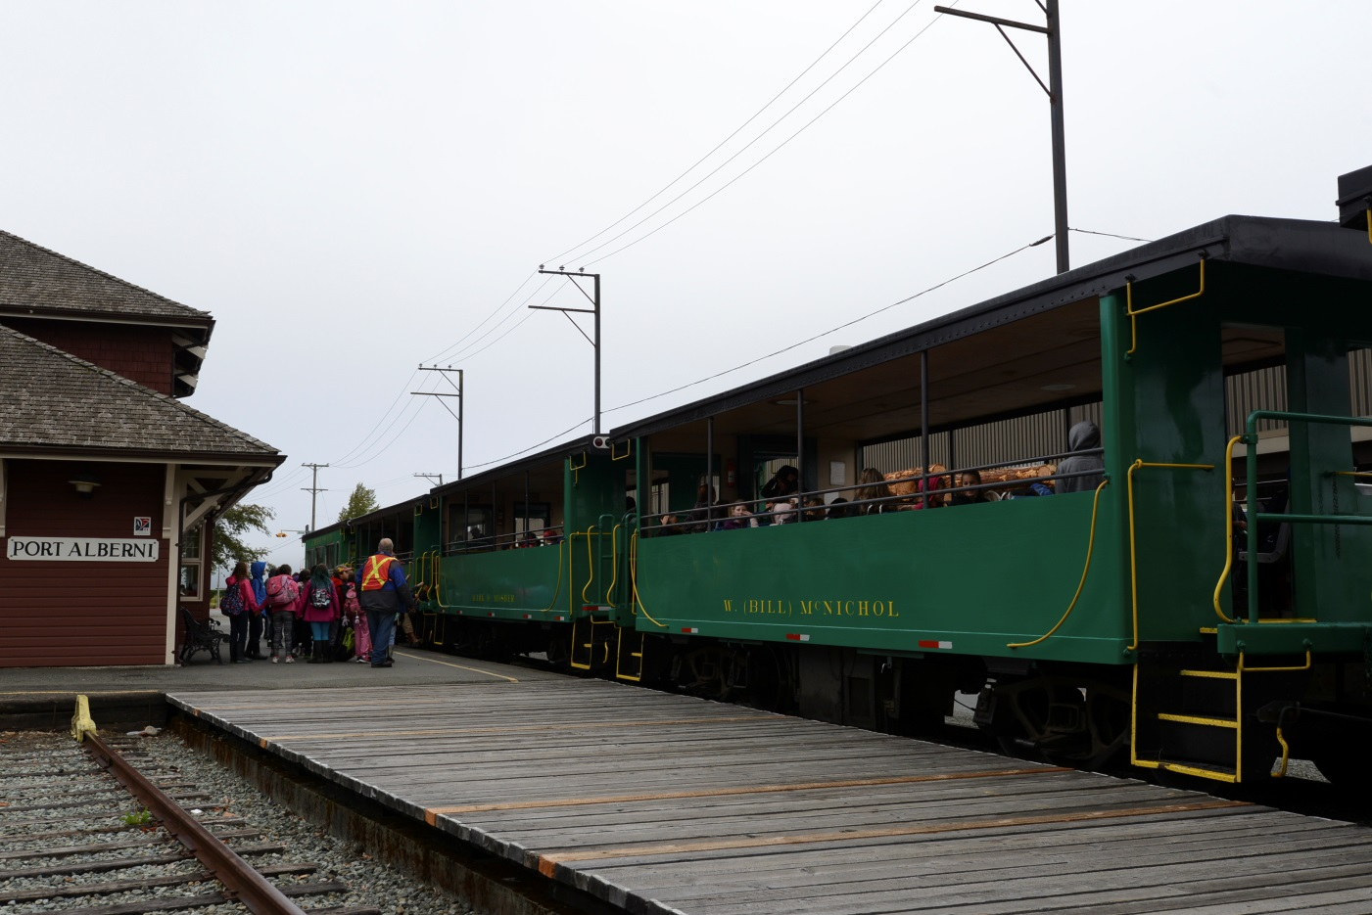
Students Boarding the Port Alberni Steam Train Destined for McLean Mill

Slide 3
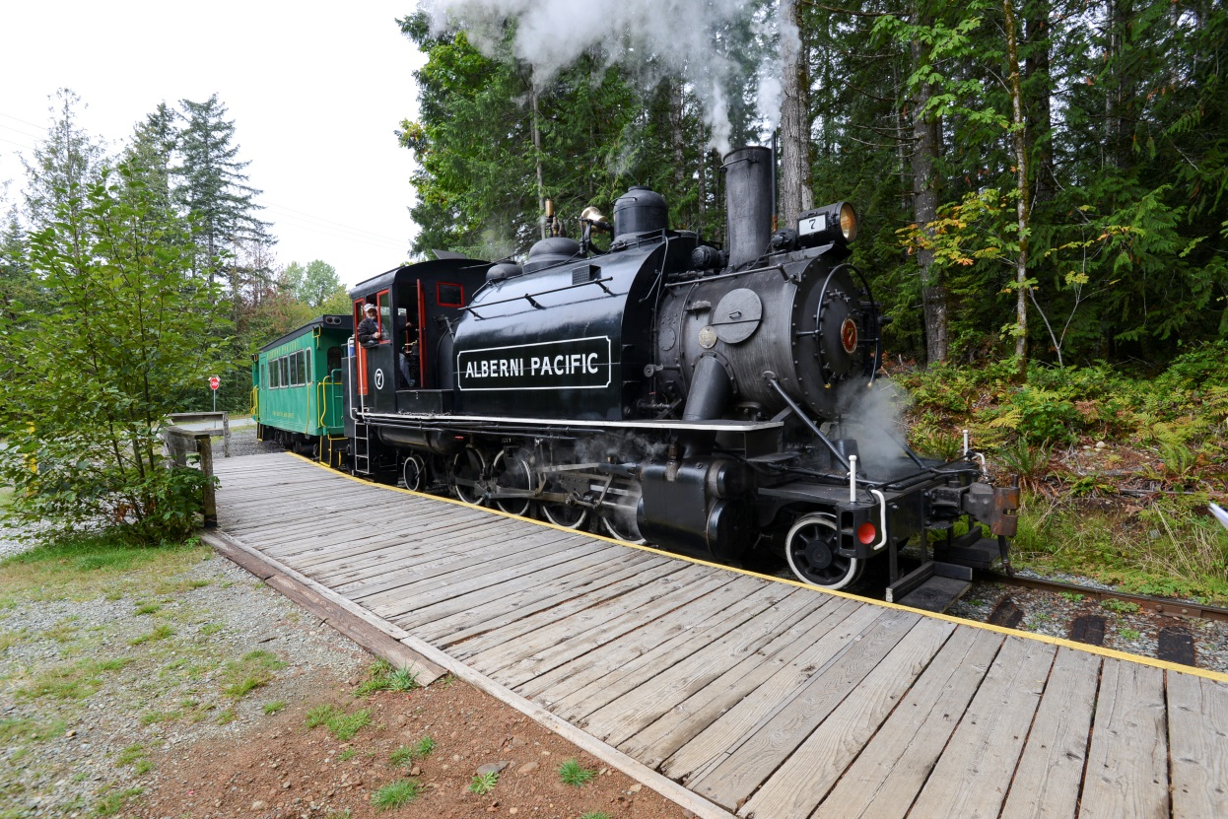
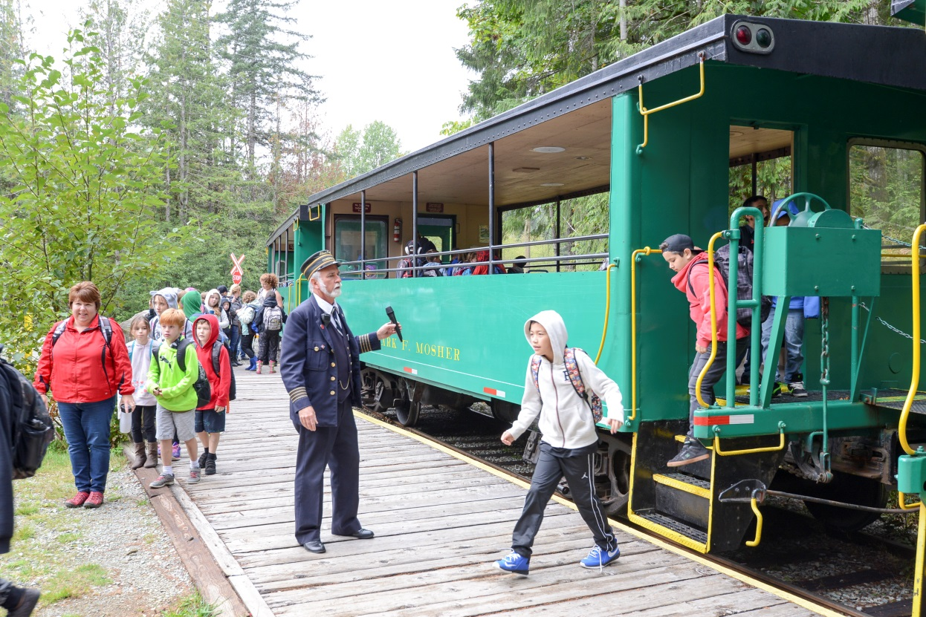
Arriving at McLean Mill

Slide 4
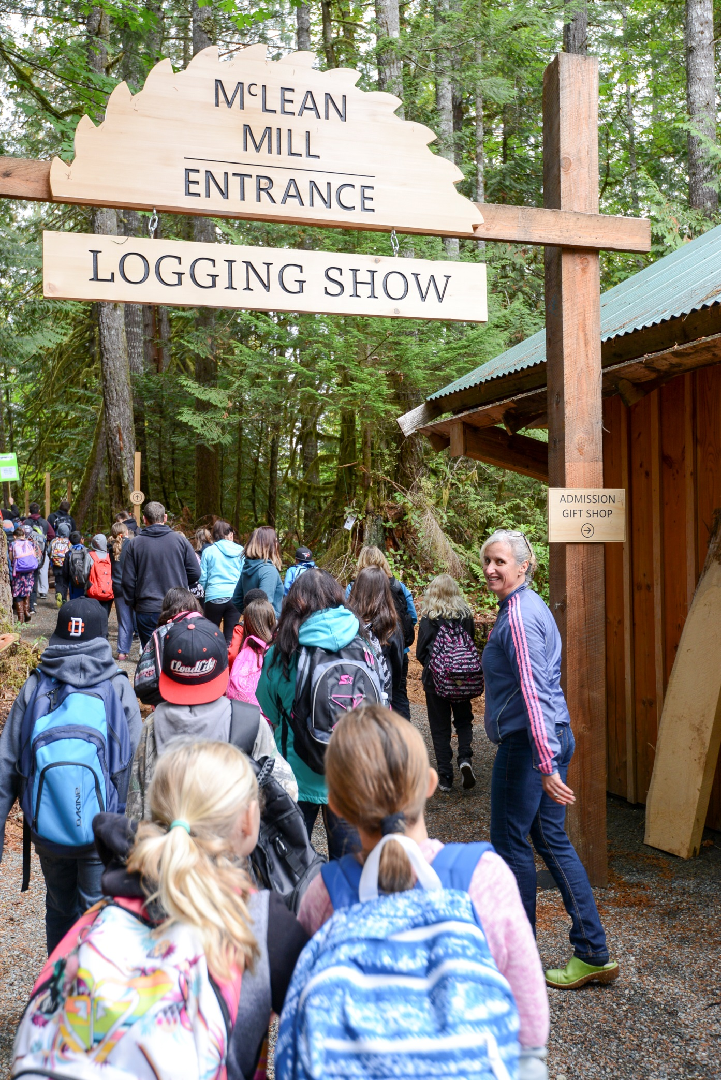

Slide 5
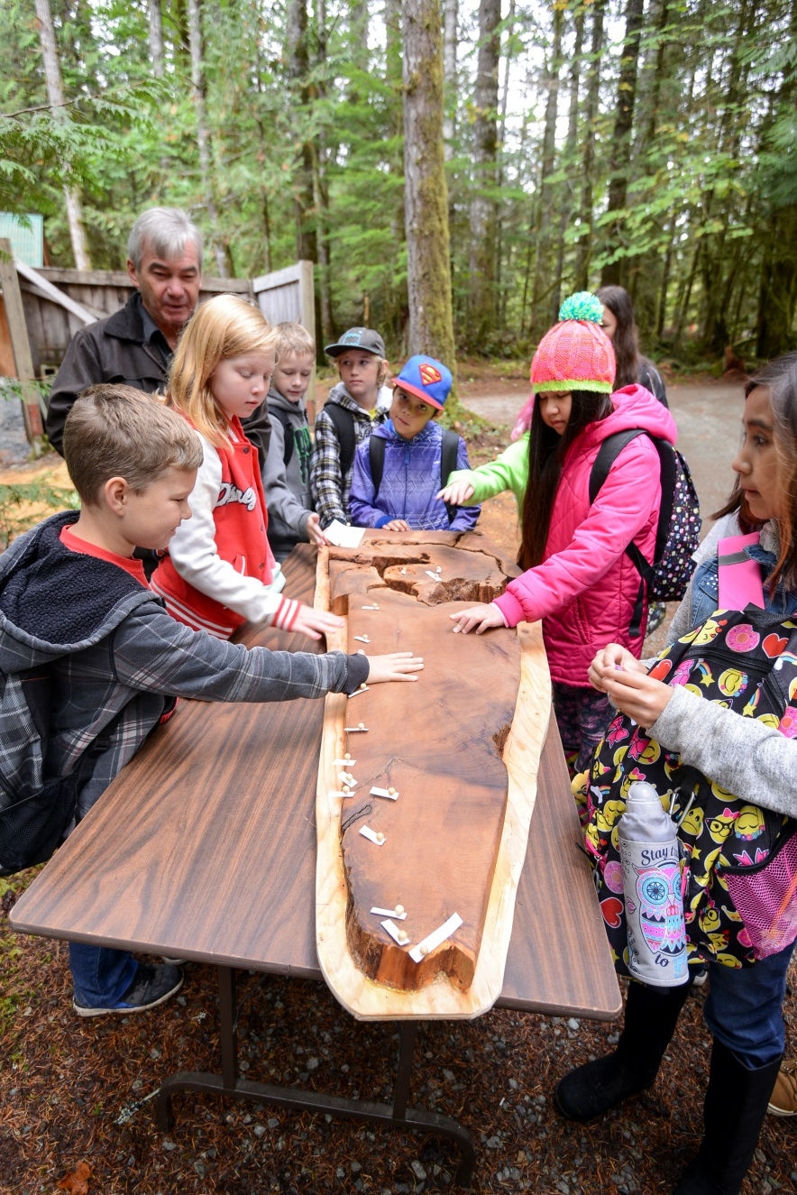
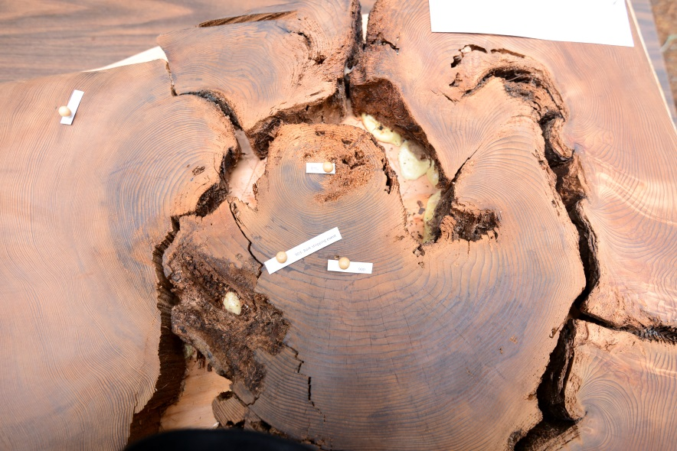
Toquaht Nation Cultural Tree Exhibit

Slide 6
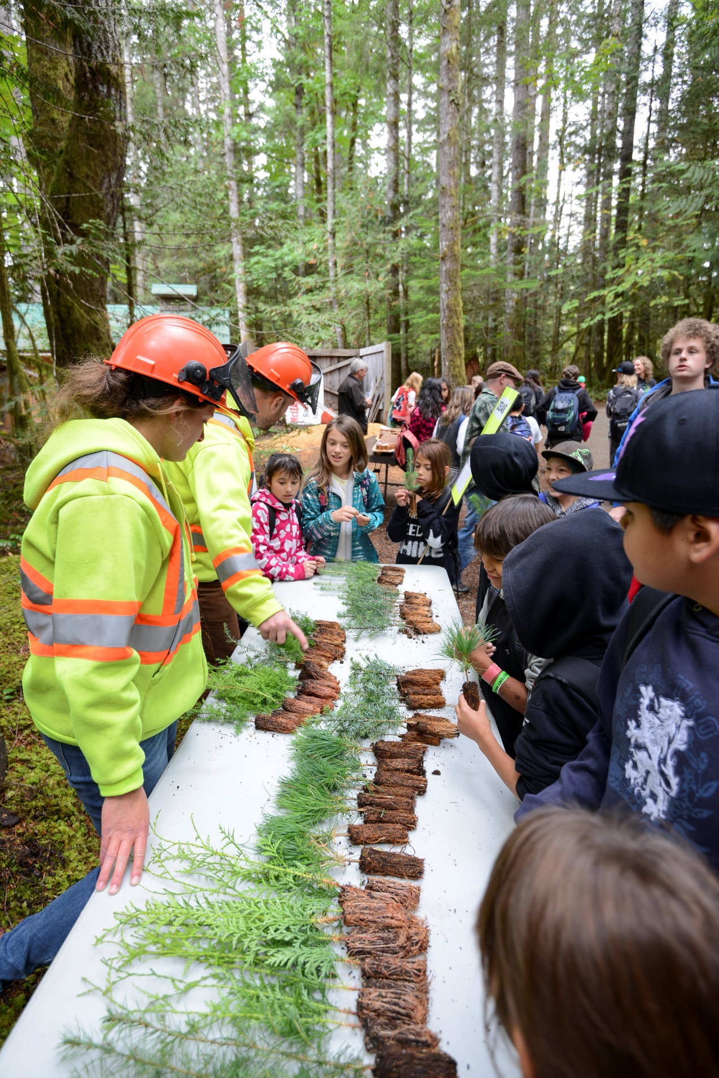
Seedling Identification

Slide 7
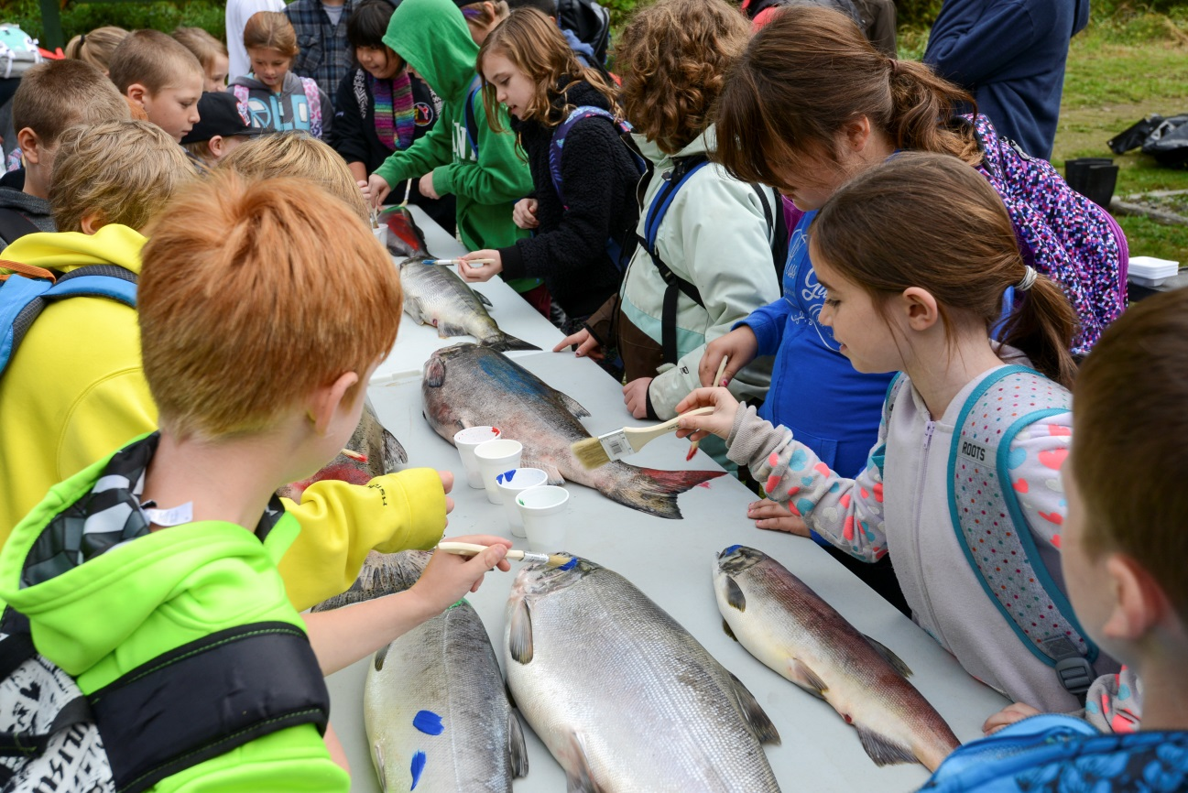
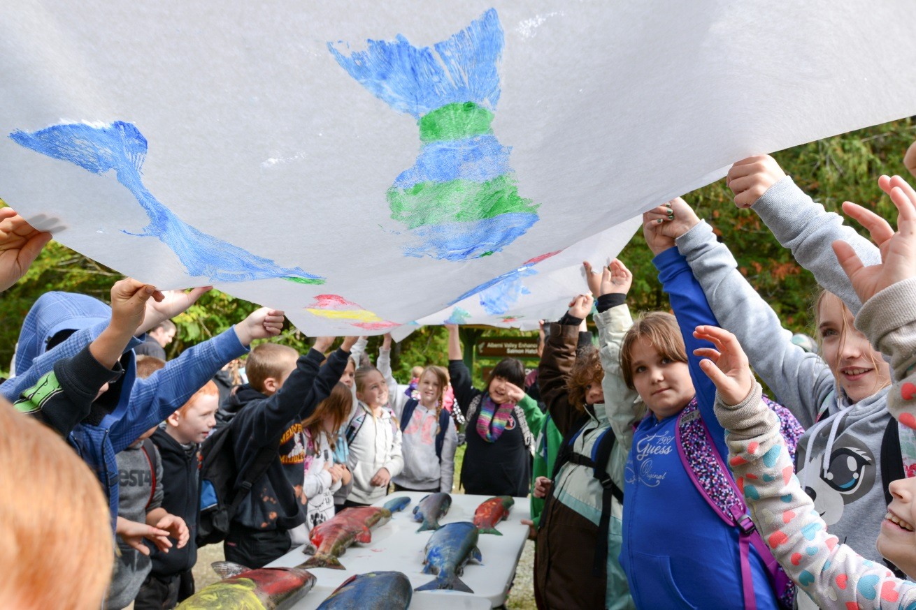
Fish Identification

Slide 8
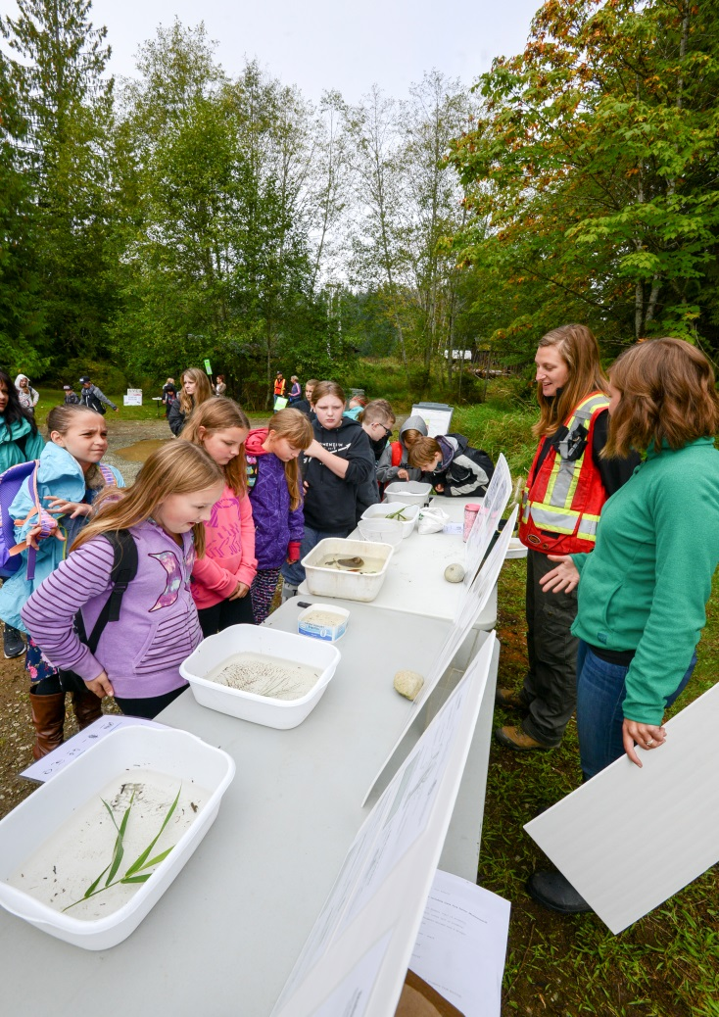
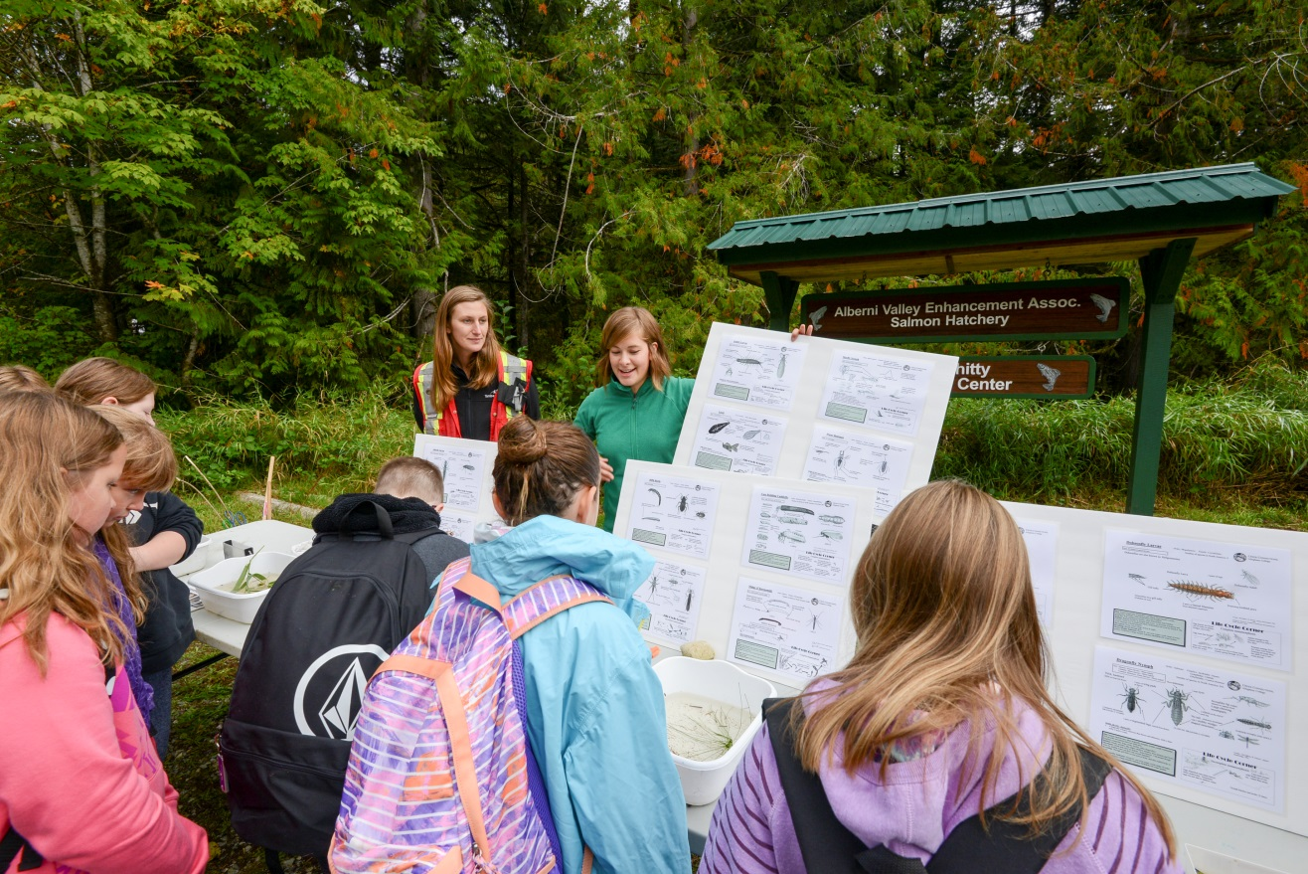
Aquatic Organisms

Slide 9
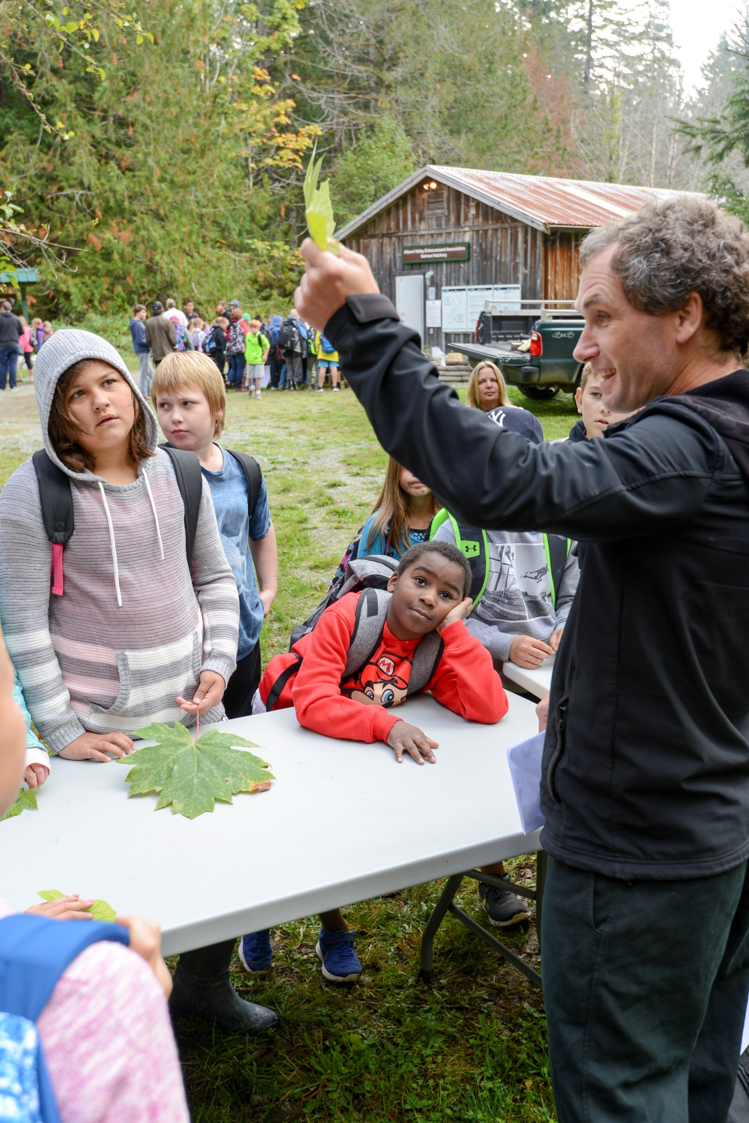
Forest Plant Identification

Slide 10
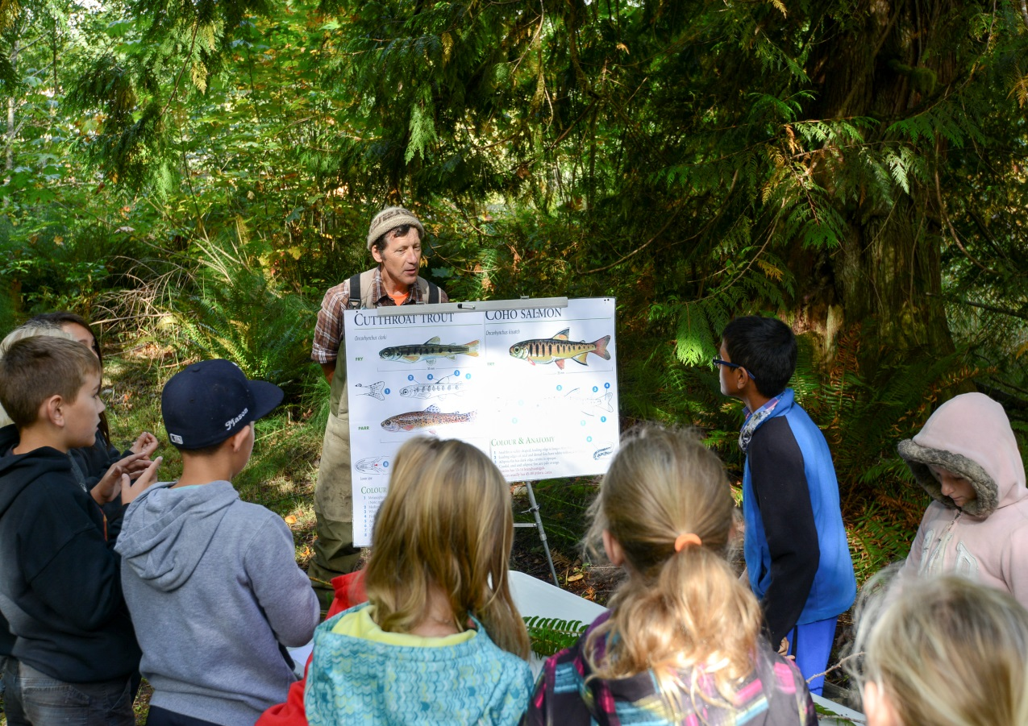
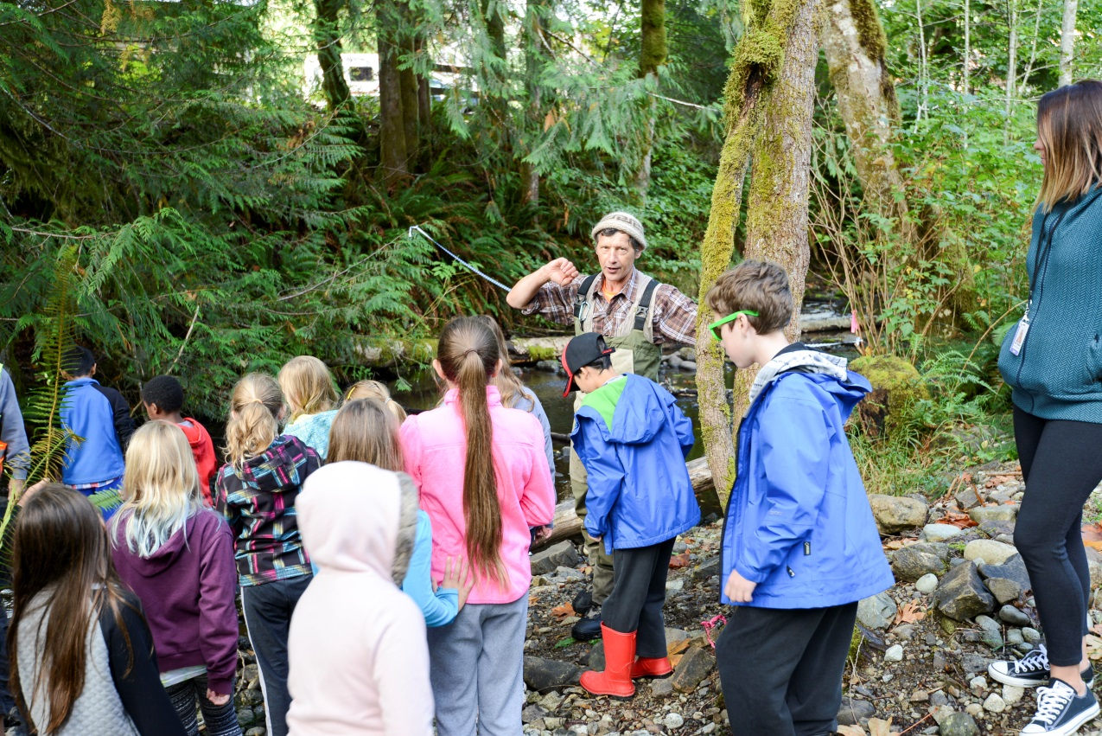
Fish and Stream Biology

Slide 11
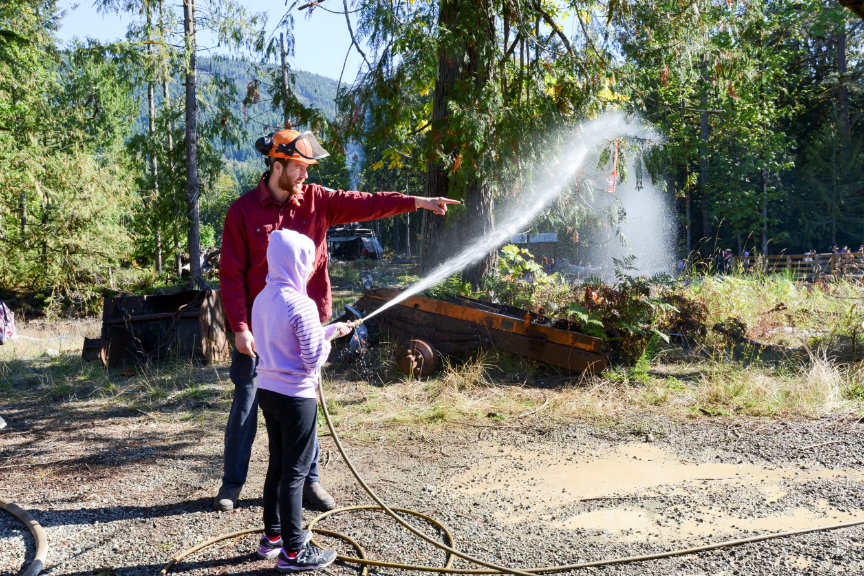
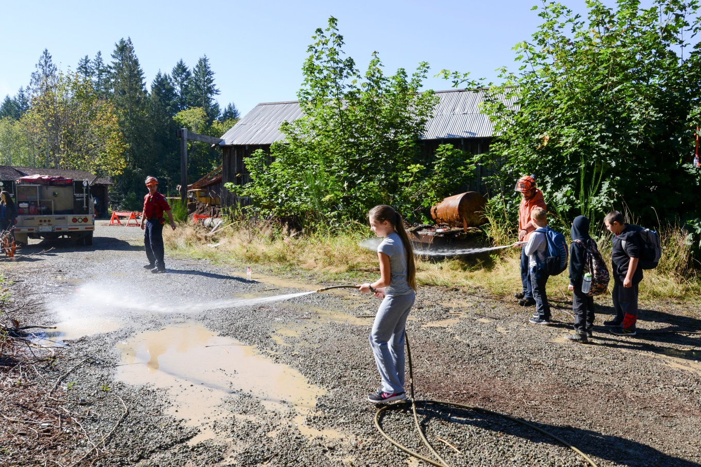
Thunderbird Fire Crew Fire Fighting Activity

Slide 12
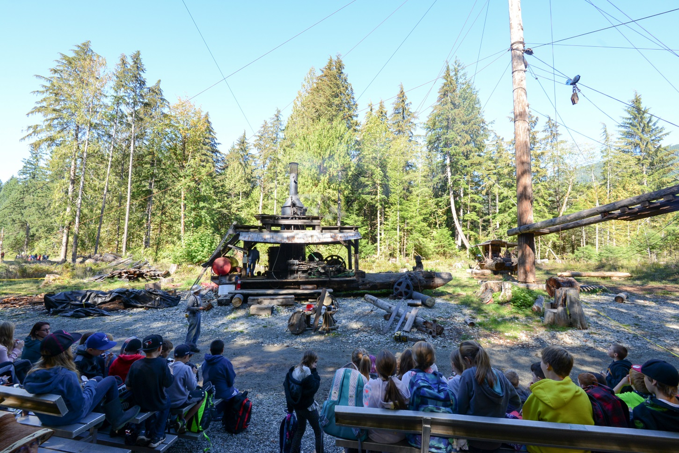
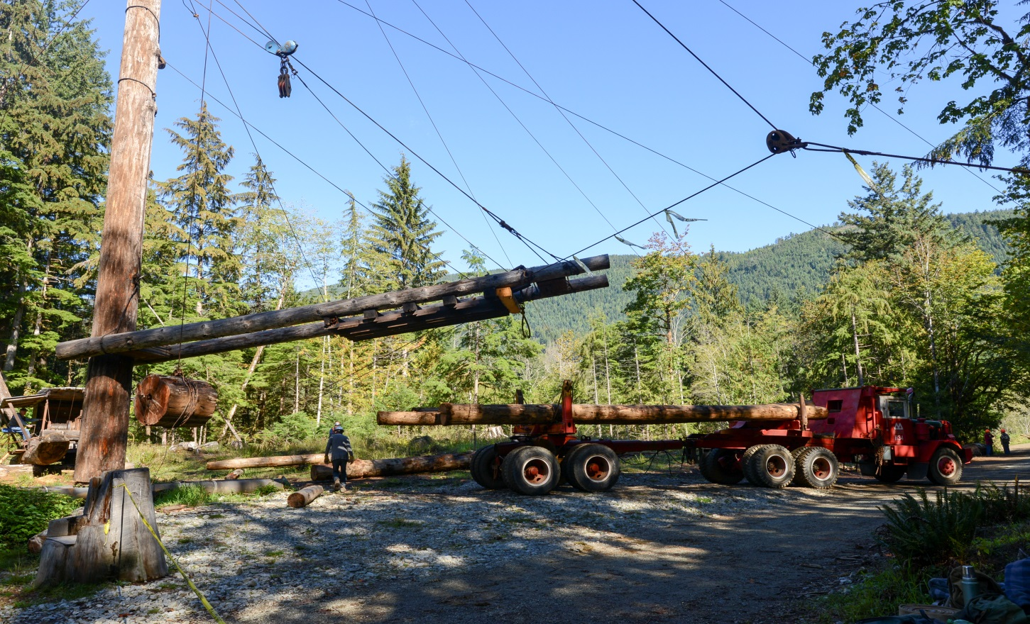
Steam Donkey Logging Demonstration

Slide 13
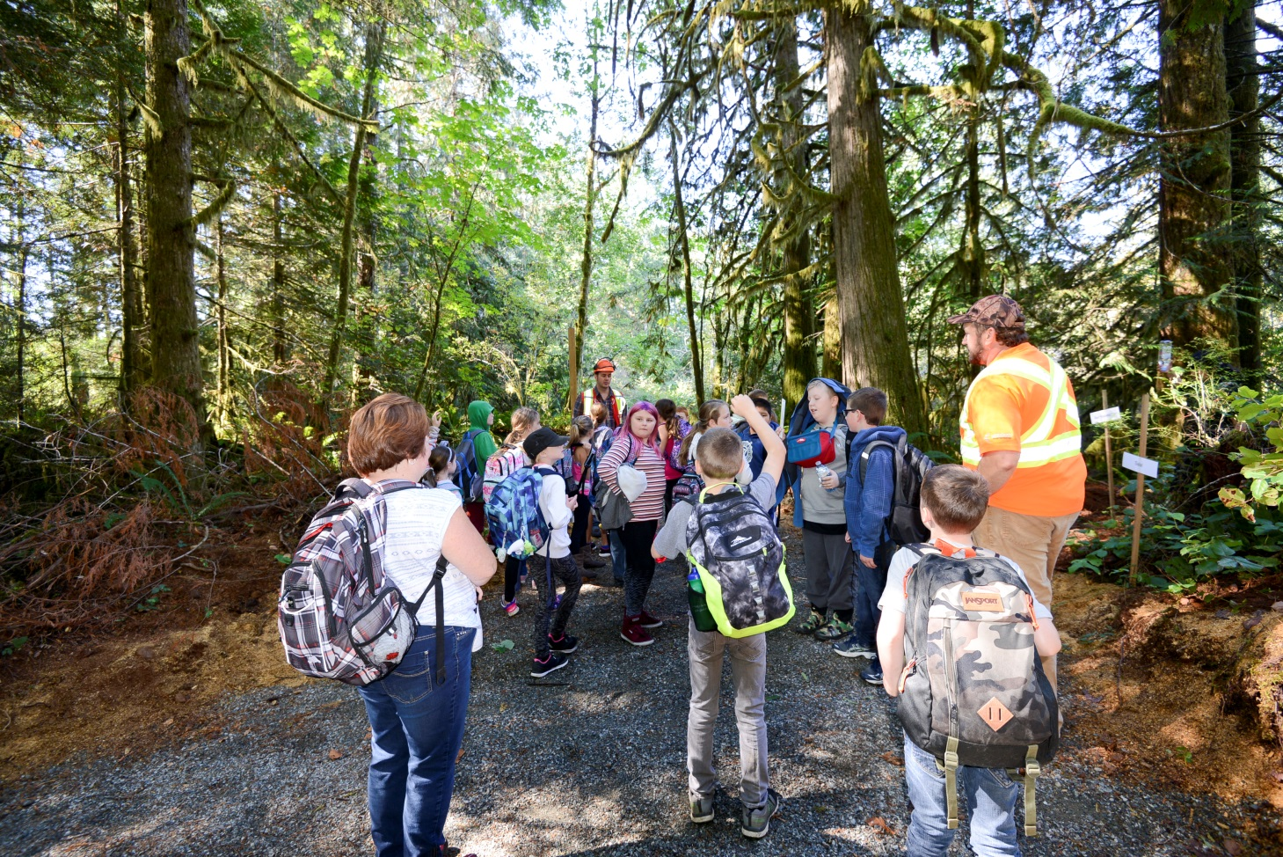
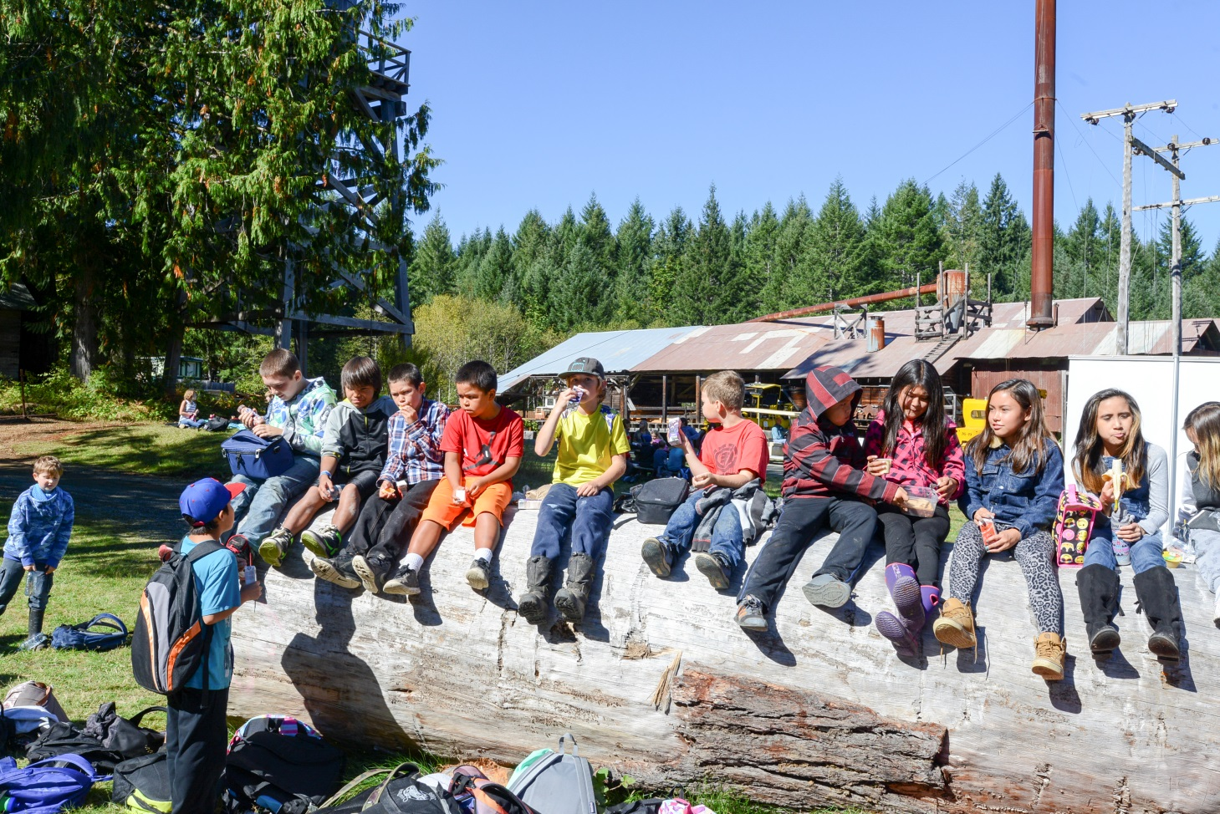

Slide 14
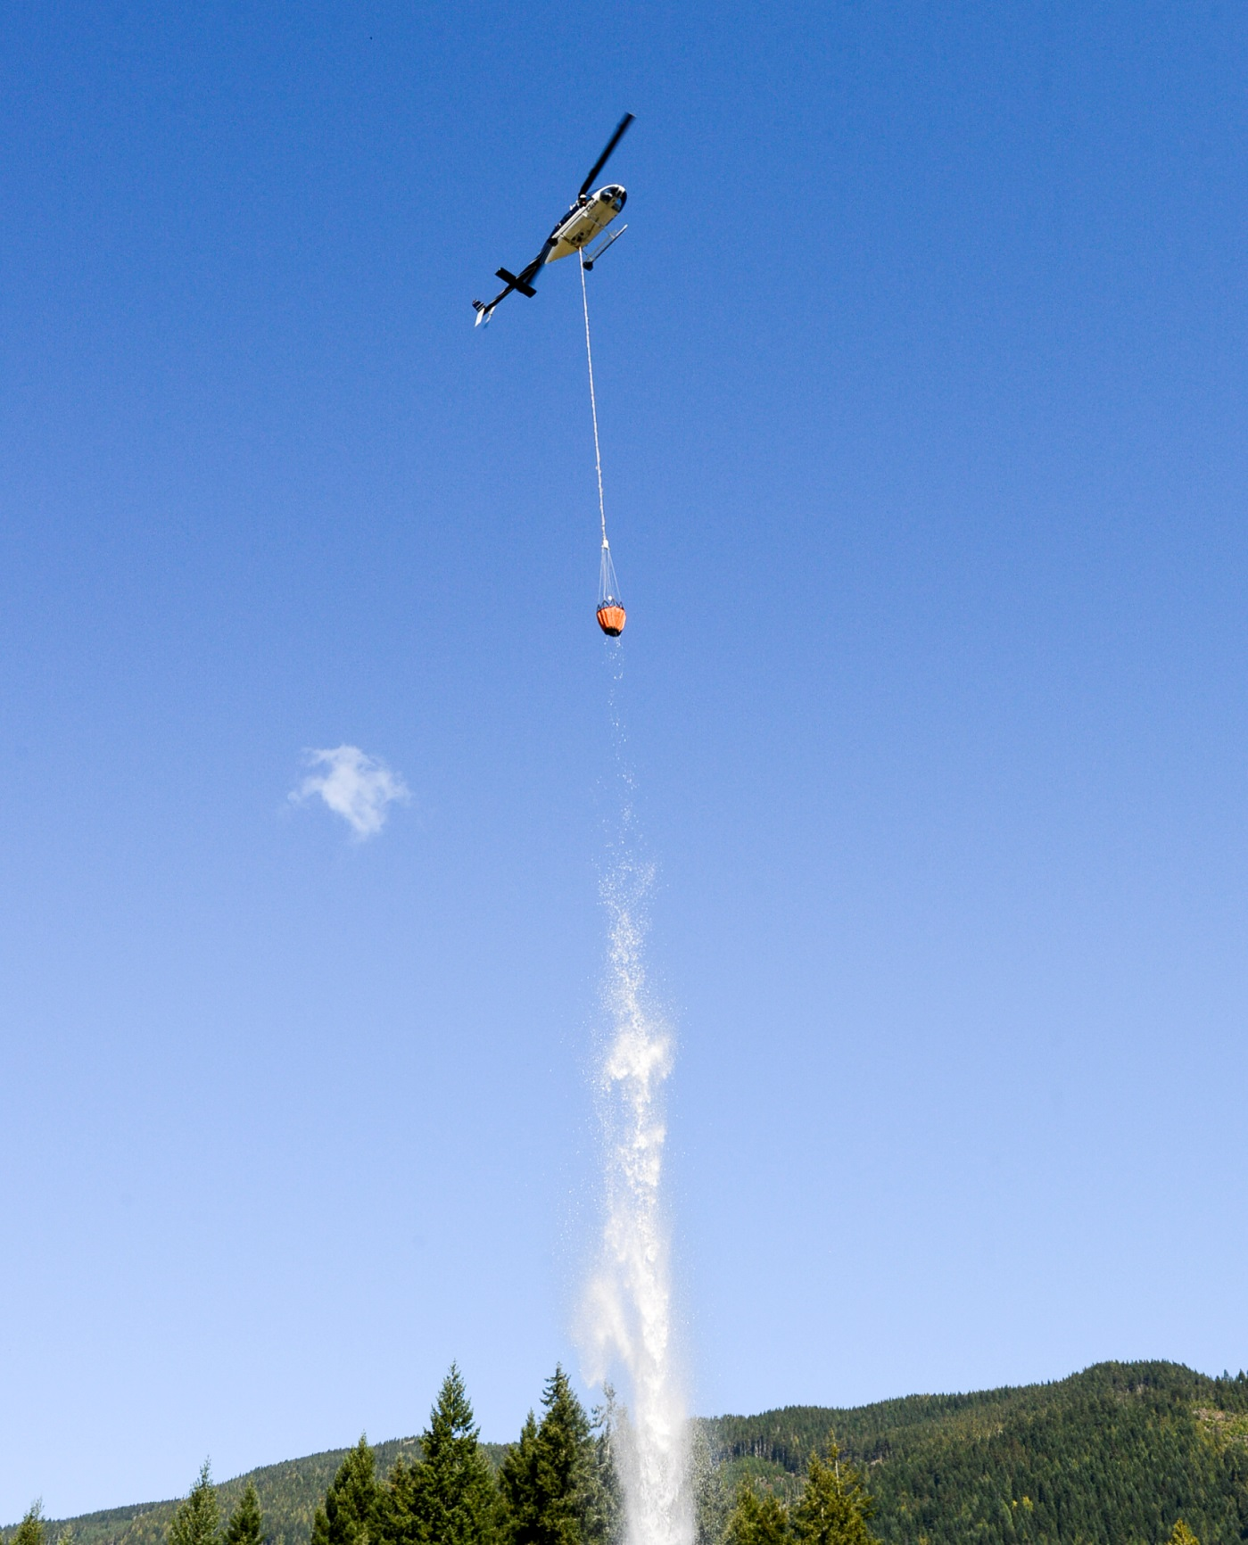
E & B Helicopters Water Drop

Slide 15
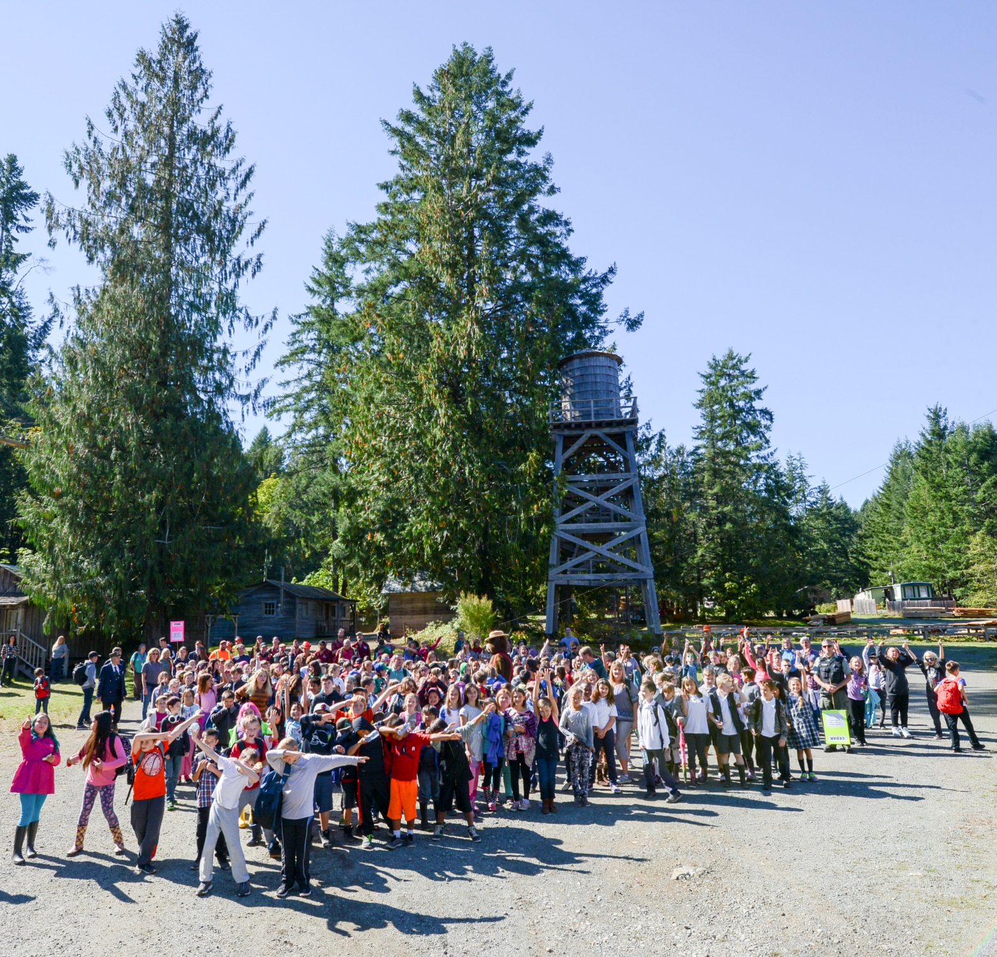

Slide 16
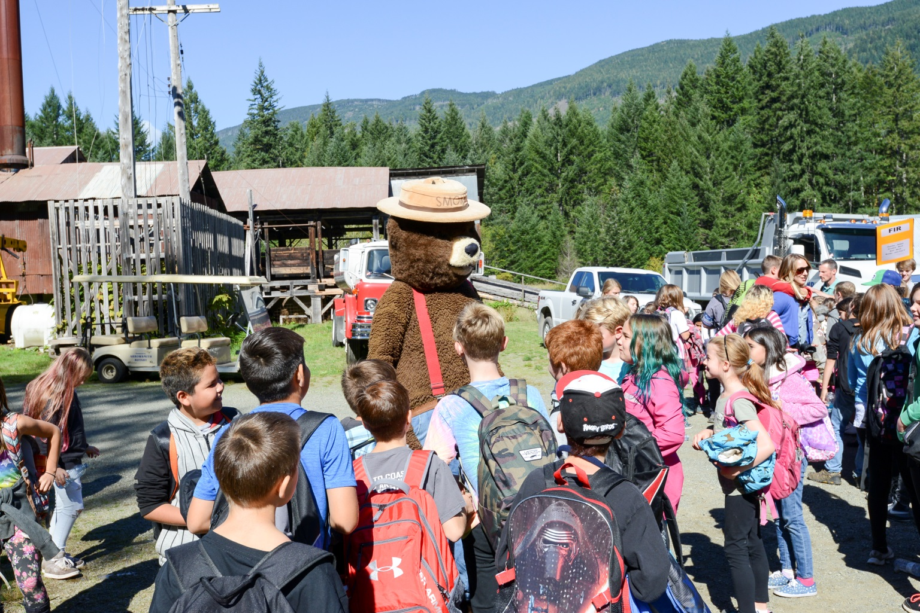
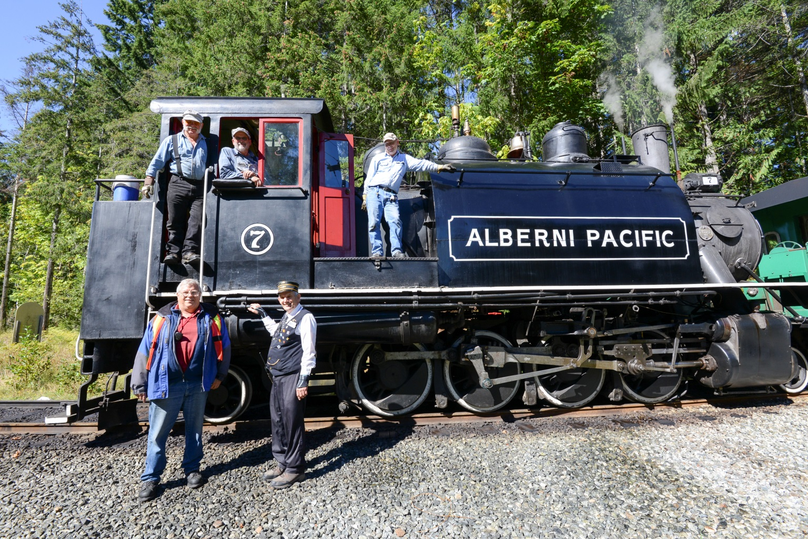

Slide 17
Thank You to all the Sponsors and Volunteers
Island Timberlands LP
Western Forest Products
TimberWest Forest Corp
South Island Natural Resource District
BC Timber Sales
Private Forest Landowners Association
Save On Foods
Toquaht First Nation
Greenmax Resources
E & B Helicopters
Alberni Valley Community Forest
Rotary Club of Port Alberni
Meridian Forest Services Ltd
See Group of Companies
Alberni Valley News
West Coast Aquatic
Mclean Mill National Historic Site
Western Vancouver Island Industrial Heritage Society

